Slide 1
Lecture 1: Software Quality, Verification, and Validation
Gregory Gay
DIT635 - January 20, 2021

Slide 2
When is software ready for release?
Notes:
Just start with a question - want you to start thinking about this. (read)
This isn’t something with one answer, or even a right answer. It’s something we’ll keep returning to

Slide 3
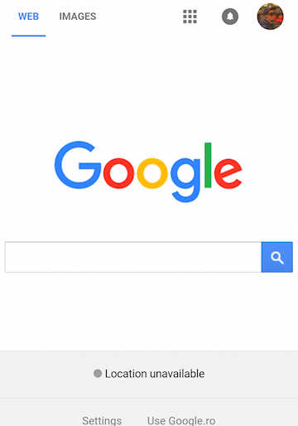
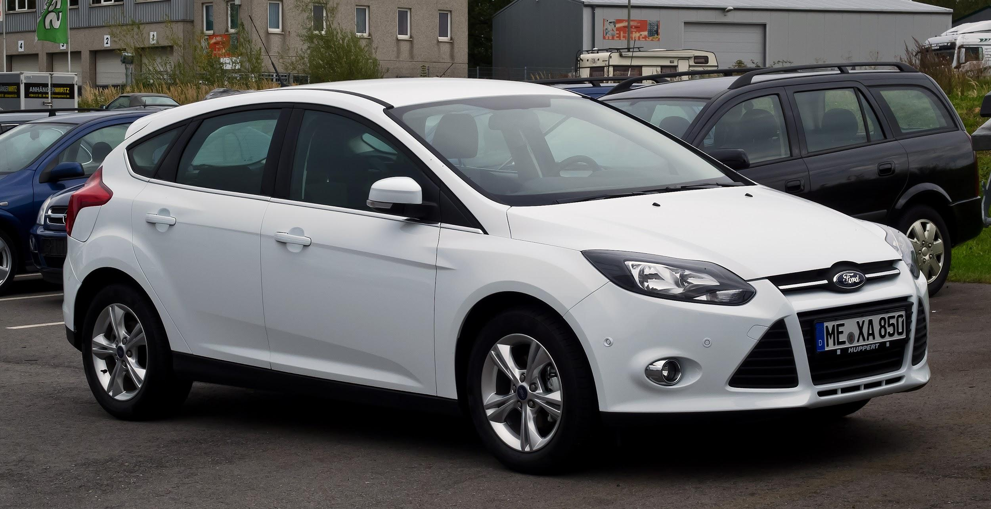
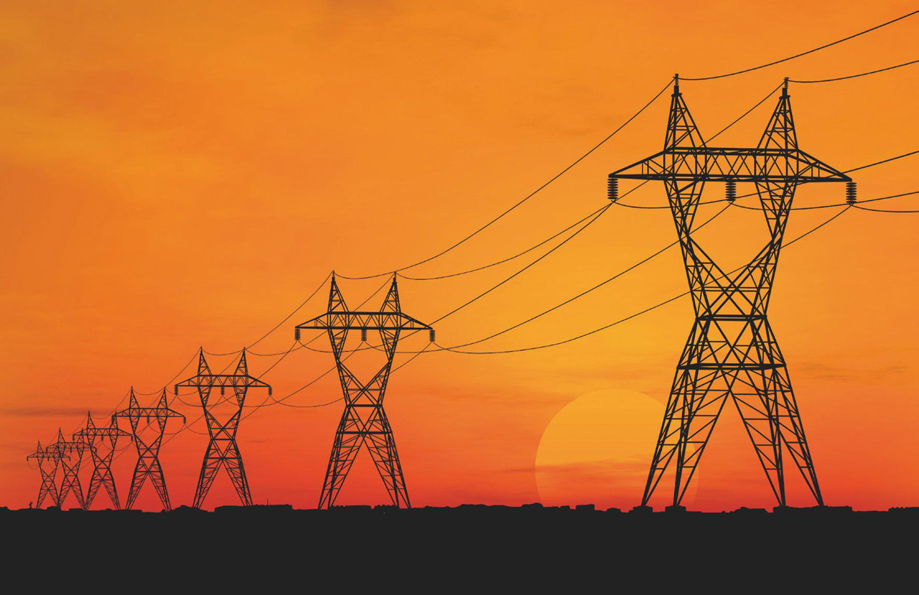
Our Society Depends on Software
This is software: So is this:
Also, this:
Notes:
Chrome, of course, is software. Excel or Word is software. No one disputes that. If I ask you about software, you’d mention something like this - a web app, a video game, a word processor. That’s not all that is software though - Our society is built on software. It powers our homes, it manages our private information, it controls our cars, it automates our factories and it even regulates our bodies. Ford is one of the largest software makers in the country. It is incredibly important that we construct good software. We need robust, operational systems, especially given growing demand for features, limited development budgets and strict time constraints.

Slide 4
Flawed Software Will Hurt Profits
“Bugs cost the U.S. economy $60 billion annually… and testing would relieve one-third of the cost.”
- NIST
“Finding and ﬁxing a software problem after delivery is often 100 times more expensive than ﬁnding and ﬁxing it before.”
- Barry Boehm (TRW Emeritus Professor, USC)
Notes:
If you screw up during design, development, or testing - if you release bad software...
software bugs hurt your bottom line. They are expensive to fix, and only become more expensive the longer they remain active. The cost of fixing bugs, handling tech support, distributing the patched software, and addressing potential legal issues is not insignificant.
In 2002, a study commissioned by the US Department of Commerce' National Institute of Standards and Technology concluded that "software bugs, or errors, are so prevalent and so detrimental that they cost the US economy an estimated $59 billion annually, or about 0.6 percent of the gross domestic product"
The report estimated that minor improvements in software testing would relieve 1/3rd of that cost.

Slide 5
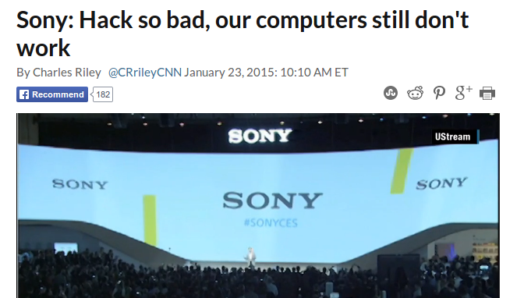
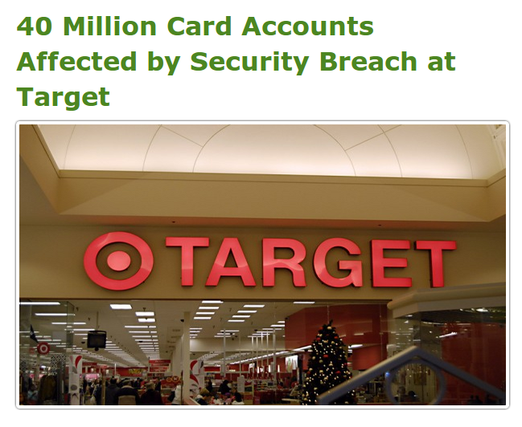
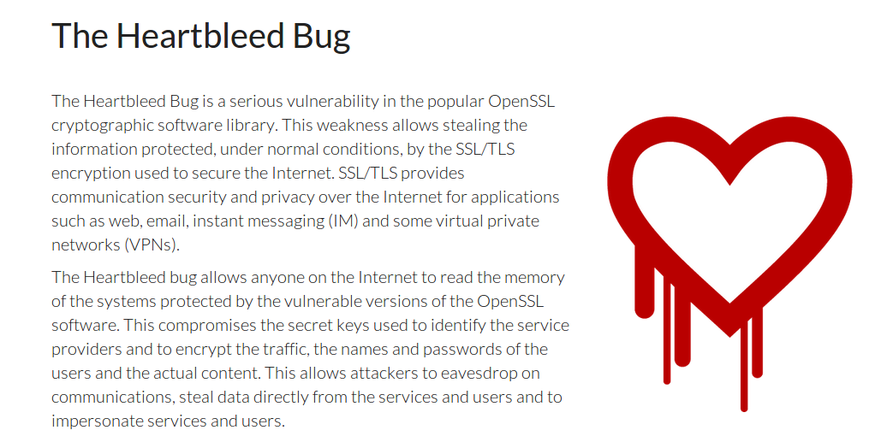
Flawed Software Will Be Exploited
Notes:
If your software is flawed, if you take short-cuts, if you don’t take security seriously, or if you don’t take the time to test your system, your flaws will be exploited. No matter how big or small you are, there are hackers working to find holes in your security, software defects they can take advantage of. You constantly see headlines about security breaches leading to leaked credit cards, or the secret documents of corporations and governments being leaked to the world. Even the software we assume is safe, the open-source code powering the modern internet, is being cracked.
Now, some of this is in the realm of security, but how you develop software matters. It may take some time, but, as a developer, improper engineering efforts will cost you. As expensive as it may be, as time consuming, to produce robust software, not taking proper engineering seriously will cost you - the loss in profit or reputation may easily outweigh the savings from releasing early.

Slide 6
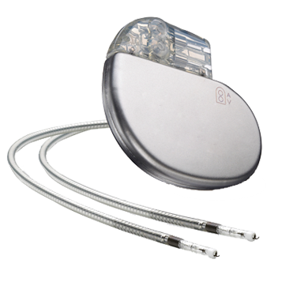
Flawed Software Will Hurt People
In 2010, software faults were responsible for 26% of medical device recalls.
“There is a reasonable probability that use of these products will cause serious adverse health consequences or death.”
US Food and Drug Administration
Notes:
Security breaches are bad - they can cripple financial instruments, they expose users to identity theft, but those are a drop in the bucket compared to the full extent of how much software can effect your life.
This little device, fits in the palm of my hand, is a pacemaker. A little block of sensors, pulse generators, and a lot of complicated software, that regulates the beating of the heart. Just one example of the growing medical device industry - little complex combinations of hardware/software that are implanted in patients and used to improve their quality of life.
In 2010, software problems were responsible for 26% of medical device recalls. These were classified by FDA as class 1 recalls, meaning (quote).
To swap one of these devices, to remove a defective one, a patient must undergo surgery - a life-threatening operation in order to fix a software issue.
This is just a single example. Software has been at fault in rocket explosions, helicopter crashes, radiation overdoses, plant failures, and more.

Slide 7
This Course
What is “good” software?
Determined through quality metrics (dependability, performance, scalability, availability, security, ...)
The key to good software?
Verification and Validation
We will explore testing and analysis activities of the V&V process.
Notes:
That is where this course comes into play. How do we delivery good software? How do we avoid flawed software?
In the first place (1) In other words, How do we assess quality? (2) So, the key to delivering robust , high-quality, software is through a thorough process known as v&v - verification and validation.
This essentially asks two things: Does the software do what we promised? Does the software meet the needs of its users?
In this course, we will explore the process of software verification and examine a variety of methods to test systems, prove their correctness, and make an argument that the software we build is reliable, dependable, and safe to use

Slide 8
Today’s Goals
Introduce The Class
AKA: What the heck is going on?
Go over course PM
Clarify expectations
Assignments/grading
Answer any questions
Introduce the idea of “quality”
Cover the basics of verification and validation

Slide 9
Contact Details
Instructor: Greg Gay (Dr, Professor, $#*%)
E-mail: ggay@chalmers.se
Website:
https://canvas.gu.se/courses/12237~42587
Pay attention to the schedule/announcements
https://greg4cr.github.io/courses/spring21dit635
Backup of Canvas page/course materials.
Likely out of date, but back-up if Canvas isn’t working.
Notes:
read off

Slide 10
Teaching Team
Teaching Assistants
Afonso Fontes (afonso.fontes@chalmers.se)
Talha Hussein (gustalhhu@student.gu.se)
Mujahid Khan (gusmujkh@student.gu.se)
Student Representatives
You?
E-mail ggay@chalmers.se if you want to volunteer.

Slide 11
Communication and Feedback
Post questions to Canvas discussion forum (preferred) or e-mail.
Send me private or sensitive questions!
Send feedback to course reps or me.
Contact student_office.cse@chalmers.se for questions related to registration, sign-up, LADOK.
Notes:
We understand that it can be difficult to get answers to your questions, particularly during online courses. We recommend the following methods for contacting the teaching staff:
Any questions related to the lectures or assignments can be asked in the Canvas discussion forum. This forum will be monitored by the teacher and teaching assistants. You may also e-mail us directly. However, we recommend posting questions to the forum to help other students who may be having similar issues.
Private or otherwise sensitive questions may be sent directly to Greg Gay (course responsible).
Course feedback can be presented to the student representatives, who will pass it on to the teachers and teaching assistants. If you have any issues that are time-sensitive or private, you may contact us directly. (last two)
We welcome course feedback, and are happy to adjust the course to correct issues affecting a majority of the students.

Slide 12
Desired Course Outcomes
Knowledge and understanding
Explain quality assurance models in software engineering and the contents of quality assurance plans
Describe the distinction between verification and validation
Name and describe the basic concepts on testing, as well as different testing techniques and approaches
Describe connection between development phases and kinds of testing
Exemplify and describe a number of different test methods, and be able to use them in practical situations
Exemplify and describe tools used for testing software, and be able to use them and interpret their output
Notes:
read off

Slide 13
Desired Course Outcomes
Competence and skills
Describe the area of formal verification in general, including model checking and runtime verification, and its relationship to software quality
Define metrics or monitoring quality of projects, products and processes
Construct appropriate and meaningful test cases, and interpret and explain (to stakeholders) the results of the application of such test cases (using appropriate tools) to practical examples
Write models in at least one formal specification language plan and produce appropriate documentation for testing
Apply different testing techniques on realistic examples

Slide 14
Desired Course Outcomes
Judgement and approach
Identify emerging techniques and methods for quality management using relevant sources
Identify and hypothesize about sources of program failures, and reflect on how to better verify the correctness of such programs

Slide 15
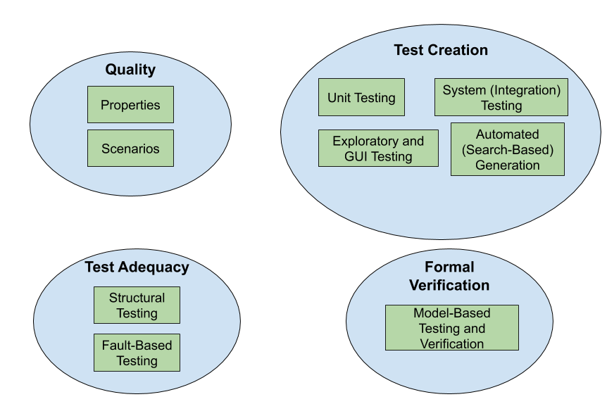
Lecture Plan (approximate)
Lectures 4 - 8, 12
Lectures 2-3
Lectures 9 - 11
Lectures 13 - 14
Notes:
read off
Quality will differ quite a bit from the rest of the class - fairly high level, why we care about this, how we assess it, some general tactics for ensuring that this form of quality is met.
Then, we dive into the process of testing, the phases of testing, and specific testing techniques (go over)

Slide 16
Changes from Last Time
Some topics removed to allow more time on others.
Slides have been revised to clarify presentation.
Changes have been made to lectures and exercise sessions to account for online teaching.
Assignments have been adjusted for clarity and to reflect changes in the topics.
Notes:
Several topics have been removed to allow more depth and examples for important topics.
Slides have been revised to present some topics more clearly.
Some changes have been made to the exercise session format and problems to account for online teaching.
Some changes have been made to lecture content to reflect online teaching.
Assignments have been adjusted for clarity and to reflect changes in the topics taught/order of topics.

Slide 17

Course Literature
Software Testing and Analysis, Mauro Pezze and Michal Young.
Free from https://ix.cs.uoregon.edu/~michal/book/free.php
Gives more information on many of the topics covered
Others posted to Canvas
Notes:
There is no mandatory course literature.
The following text book is optional:Mauro Pezze, Michal Young. Software Testing and Analysis: Process, Principles, and Techniques. 2008. John Wiley & Sons, Inc., USA.
Students can request a free copy of the textbook from https://ix.cs.uoregon.edu/~michal/book/free.php (Links to an external site.).
This book was used during the creation of some of the slides, and provides additional background material for many of the course topics. Students are recommended to request their free copy for use when studying the testing material in the course. This book was used during the creation of some of the slides, and provides additional background material for course topics. Students are recommended to request a free copy for use when studying the testing material in the course. As this book is several years old, we make use of theoretical content that is still relevant, while discarding outdated theory and updating specific technologies. Additional optional readings will be provided for individual topics. On Canvas, there is a schedule page. For each lecture, we will post links to additional reading material

Slide 18
Prerequisite Knowledge
You need to be proficient in Java
(ideally, some knowledge of C/C++)
Basic understanding of build systems and continuous integration
We will go over specifics later.
Basic understanding of logic and sets.
Formal verification based on logical arguments.
Notes:
(go over - the main language for examples will be Java, and we will be using JUnit - don’t need to know JUnit already

Slide 19


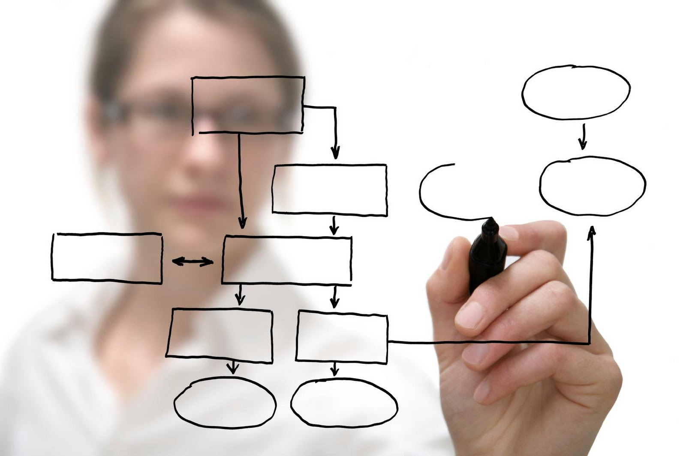
Course Design
Lectures (Wed 8:15-10:00, Friday 10:15-12:00)
Exercise Sessions (Friday, 13:15-15:00)
Group Assignments
Notes:
Most of the time, we’re in normal class mode. I will stand up here and drone at you, then toss in a joke to keep you awake. This is twice a week - Wednesday 8:15-10, Friday 10:15-12. Attendance in the lecture is highly recommended, but not mandatory. Note that any material covered in lectures can be referred to in the project and exam (i.e., not just material written in the slides).
Then, because it’s boring to just listen to me talk. For me too. We’ll do weekly exercise sessions. We’ll work through larger problems, try to put some of the ideas from class into practice. Get more examples to work through. We will also do small exercises during a lot of the individual class sessions. When we do these, I expect you to give them a try and volunteer answers - I’ll wait here awkwardly until you do. Anyways, Exercise sessions are also a time to get help on homework. I will be there, as will the TAs. I’ll give some introduction at the start and some explanation, then you can work on the exercise and ask questions. We can do breakout rooms with groups or just work through things as a class. This is a combination office hour and bonus explanation/problem session. Attendance in supervision sessions is, again, highly recommended but not mandatory.
Then there will be Assignments. Work in groups of three on problem sets. Another step up in complexity from the exercise sessions. Think of this as theory in lectures, to hands-on problems in exercises, to practice in assignments.

Slide 20
Online Lectures
All lectures and exercise sessions on Zoom.
Lectures recorded and links posted to Canvas.
Use real names, mute/no camera, ask questions via chat.
(exercise sessions may be more interactive)
Notes:
(1). They will be streamed live, and recorded. (2). The only exception is when we have industrial speakers, where we may not be able to record due to IP restrictions. We’ll check on that as we get closer to those talks. In any case, attendance is still highly recommended in the live lectures so you can ask questions and get clarification. It will be really helpful both for you and me if you attend live and interact. (3 -4), so during those, we might do microphones and cameras - especially in breakout rooms - but during the main class, there are a lot of people potentially, so let’s use the chat for the sake of simplicity.

Slide 21
Examination Form
Sub-Courses
Written examination (Skriftlig tentamen), 4.5 higher education credits
Grading scale: Pass with Distinction (VG), Pass (G) and Fail (U)
Assignments (Inlämningsuppgifter), 3 higher education credits
Grading scale: Pass (G) and Fail (U)

Slide 22
Assessment
Individual hall exam at end of course
Written assignments in teams of three.
You may choose your own team.
E-mail names to ggay@chalmers.se
E-mail if you want to be assigned to a team.
Three written assignments.
Equally weighted.
Final grade is average of three assignment grades.
Notes:
The course is examined by an individual written exam carried out in an examination hall at the end of course and written assignments normally carried out in groups of three students. The assignments part is examined on the basis of solutions to compulsory problems handed in during the course and on the basis of individual contribution to the group work.
There will be three group written assignments. Each assignment is equally weighted. Specific requirements for the assignments will be provided on Canvas.The final grade for the assignment part of the course (3 credits) will be an average of the grade for each of the three assignments. If the average grade across the assignments is passing, the students will receive a passing grade for the assignment part of the course. Failing one of three assignments does not necessarily mean there will be a failing grade for the assignments part of the course.

Slide 23
Assessment
Self and peer-evaluation due with each assignment
May be used to adjust individual assignment grades.
AKA: don’t slack off!
Late assignments, -20% per day, 0% after two days
If final assignment average is failing, all three assignments must be redone/resubmitted.
Notes:
Students are required to complete written self- and peer-assessment forms during the course which will be part of the assessment of the student's individual contribution to the project. The instructor may adjust the individual grades of a student depending on this evaluation. Note that although the grade is given for a group assignment, this grade is then assigned individually to students, and may be adjusted depending on the peer evaluation form. Thus, not all students in the same group are guaranteed to get the same grade. Such situations are rare.
(4)
If the final average grade of all assignments is a failing grade, all three assignments must redone and resubmitted with a new case. The redone assignments are handed in again at a date after course completion. A new case will be provided. Redone assignments can be done in groups or individually.

Slide 24
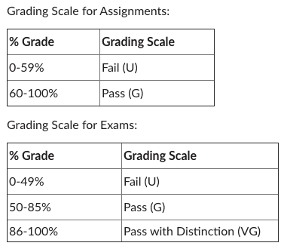
Grading Scale
Assignments: Pass (G), Fail (U)
Exam: Pass w/ Distinction (VG), Pass (G), Fail (U)
Notes:
The grading scale differs for assignments vs. the exam. For the assignments, the GU grades Pass (G) and Fail (U) are used, for the exam, we use Pass with Distinction (VG), Pass (G) and Fail (U) for GU students. To be awarded Pass (G) for a full course, the students must pass both the exam part and the assignments part with at least grade (G). To be awarded Pass with Distinction (VG) for a full course, the student must, in addition, receive a VG on the written exam part. Essentially, your final overall grade is the grade you get on the exam, as long as the assignment part of the course has been passed. Written assignments and the final exam will be graded on a numeric scale, converted to percentages. The final percentage grade for the assignments and exams will be converted as follows:

Slide 25
Expected Workload
This class can be time consuming.
Understanding the material takes time.
Project work requires team coordination.
Do not underestimate the project work.
Good engineering is hard.
Planning and scheduling your time is essential.
Do NOT delay getting started.
Appoint a team leader (and rotate the role)
Notes:
project -
We’re not trying to make things arbitrairly hard to justify teamworks, but good engineering is hard - it takes time adn work
planning/scheduling is essential. most issues come from people starting too late and trying to cram. That doesn’t work here. Especially given the need for teamwork. Working together takes planning.
You can’t slack off - we do use peer evaluations in grading, and if you don’t take part, you won’t get the grade.
Team leader (read)

Slide 26
Other Policies
Integrity and Ethics:
Homework and programs you submit for this class must be entirely your own. If this is not absolutely clear, then contact me. Any other collaboration of any type on any assignment is not permitted. It is your responsibility to protect your work from unauthorized access. Violation = failing grade and reporting.
Classroom Climate:
Arrive on time, don’t talk during lecture, don’t use chat unless asking or answering questions. Disruptive students will be warned and dismissed.
Notes:
(integrity) The homework and programs you submit for this class must be entirely your own. If this policy is not absolutely clear, then please contact me. Any other collaboration of any type on any assignment is not permitted. It is also your responsibility to protect your work from unauthorized access. Any violation of this policy will result - at minimum - in a failing grade on the assignment. Further infractions will result in a failing grade in the course and further disciplinary action. More information on plagiarism will be provided on the Canvas page. We recommend referring to this material for more information.
(climate) All students are expected to behave as scholars at a leading institute of technology. This includes arriving on time, not talking during lecture (unless addressing the instructor), and not causing disruption in the classroom chat - only use it to ask or answer questions. Disruptive students will be warned and potentially dismissed from lectures.

Slide 27
Other Policies
Diversity
Students in this class are expected to work with all other students, regardless of gender, race, sexuality, religion, etc. Zero-tolerance policy for discrimination.
Special Needs
We will provide reasonable accommodations to students that have disabilities. Contact teaching team early to discuss individual needs.
Notes:
Someday you will graduate, and in the real world, you will have to work with a wide variety of people. Now is the time to abandon preconceived prejudices about others. Students in this class are expected to respectfully work with all other students, regardless of gender, race, sexuality, religion, or any other protected criteria. There is a zero-tolerance policy for any student that discriminates against other students for any reason.
It is university policy to provide, on a flexible and individual basis, reasonable accommodations to students that have disabilities that may affect their ability to participate in course activities or to meet course requirements. Students with disabilities are encouraged to contact their instructor early in the semester to discuss their individual needs for accommodations.

Slide 28
Let’s take a break!
Notes:
Just start with a question - want you to start thinking about this. (read)
This isn’t something with one answer, or even a right answer. It’s something we’ll keep returning to

Slide 29
When is software ready for release?
Notes:
Just start with a question - want you to start thinking about this. (read)
This isn’t something with one answer, or even a right answer. It’s something we’ll keep returning to

Slide 30
The short (and not so simple) answers...
We release when we can’t find any bugs…
We release when we have finished testing…
We release when quality is high...
Notes:
(go over these)
1 - how do you know there aren’t any we haven’t discovered?
2- How do we know we’re done?
3 - What does that mean? What is quality to you? When is it high?

Slide 31
Software Quality
We all want high-quality software.
We don’t all agree on the definition of quality.
Quality encompasses both what the system does and how it does it.
How quickly it runs.
How secure it is.
How available its services are.
How easily it scales to more users.
Quality is hard to measure and assess objectively.
Notes:
We all want high-quality software, we all agree that quality is necessary. However, we don’t all agree on what quality means. Ask ten people, and they may describe ten things. Why? (3) what a system does is only part of the story and that how the system provides its services often has a huge impact on the perceptions that stakeholders have of it. (rest)

Slide 32
Quality Attributes
Describe desired properties of the system.
Developers prioritize attributes and design system that meets chosen thresholds.
Most relevant for this course: dependability
Ability to consistently offer correct functionality, even under unforeseen or unsafe conditions.
Notes:
Quality attributes describe desired properties of the system under development. Developers must prioritize quality attributes and design a system that meets chosen thresholds.
Most relevant for this course: dependability. Ability of the system to consistently offer correct functionality, even under unforeseen or unsafe conditions.

Slide 33
Quality Attributes
Performance
Ability to meet timing requirements. When events occur, the system must respond quickly.
Security
Ability to protect information from unauthorized access while providing service to authorized users.
Scalability
Ability to “grow” the system to process more concurrent requests.
Notes:
Here are other ways we assess quality
- (2) How components are structured and communicate influences performance. One of your biggest bottlenecks is often in communication between subsystems, especially over a network. So, performance can often be improved by localizing critical operations into fewer, but larger, components. Install more of your system locally, rather than on a remote server, so that computation doesn’t depend on network latency. Consider how to execute components of the system in parallel, for more efficiency.
- (4) If security is a concern, you might want to layer the architecture, with the critical components protected in innermost layers , with a high level of security validation applied to the higher layers. Architect the system to trap attackers with multiple layers of gates between them and critical assets.
- (5)

Slide 34
Quality Attributes
Availability
Ability to carry out a task when needed, to minimize “downtime”, and to recover from failures.
Modifiability
Ability to enhance software by fixing issues, adding features, and adapting to new environments.
Testability
Ability to easily identify faults in a system.
Probability that a fault will result in a visible failure.
Notes:
- (2) If availability is a critical requirement, the architecture should be designed with redundancy in mind - always make it possible to replace components in case of trouble and update components without stopping the system. This is called a “fault-tolerant” system. You’ll see terms like triple reudndancy, where things like spacecraft systems will have three copies of software or hardware running at once, and makre sure they agree, or ensure that there is always a backup if something goes wrong.
- (4) If you want a high degree of maintainability, you need a larger number of small, self-contained components. That’s the idea of high cohesion and low coupling. Keep related functions together, and as independent as possible - separate data from consumers, avoid shared data structures - then you can more easily fix bugs and add features to these little independent subsystems.
- (6) a well-designed system is able to amplify a failure - ensuring that you notice problems, rather than getting subtlely wrong answers or missing issues until it is too late. For instance, the system design can determine what information is visible for inspection when testing, and a system could be designed to surface information to a special testing interface designed to provide data that would not otherwise be visible to the world.

Slide 35
Quality Attributes
Interoperability
Ability to exchange information with and provide functionality to other systems.
Usability
Ability to enable users to perform tasks and provide support to users.
How easy it is to use the system, learn features, adapt to meet user needs, and increase confidence and satisfaction in usage.
Notes:
- (2) This is not useful in isolation, but is defined by context - by identifying with whom, what, and under what circumstances the system is supposed to communicate and work with .The idea here, however, is that the architecture is designed to provide the right data and functionality to external sources in a controlled manner.
(4-5) Naturally, this most centrally relates to user interfaces, but impacts the entire architecture and how users work with it.

Slide 36
Other Quality Attributes
Resilience
Supportability
Portability
Development Efficiency
Time to Deliver
Tool Support
Geographic Distribution

Slide 37
Quality Attributes
These qualities often conflict.
Fewer subsystems improves performance, but hurts modifiability.
Redundant data helps availability, but lessens security.
Localizing safety-critical features ensures safety, but degrades performance.
Important to decide what is important, and set a threshold on when it is “good enough”.
Notes:
Now, unfortuantely, emphasizing one of these qualities tends to lessen another quality. They conflict with each other. It is hard to achieve multiple qualities at once.
Using a small number of complex subsystems components improves performance because there are fewer bottlenecks, but hurts maintainability, as it’s harder to add features or make changes to complex subsystems.
(read) - you need to protect all of that data equally, and that’s infinitely harder than protecting data in one place.
Localizing safety-critcical features to one module on a local machine introduces more communication between subsystems, possibly in remote locations, degrading performance, but does improve safety
(last point), we’ll talk more about that over the next three classes

Slide 38
When is Software Ready for Release?
Software is ready for release when you can argue that it is dependable.
Correct, reliable, safe, and robust.
Shown through Verification and Validation.
Notes:
So, back to the question… the first crack we’ll take at an answer - and you’ll see pretty soon why this is so complicated - is that (read).
This is usually measured along four dimensions (2).
The primary process of making software dependable (and providing evidence of dependability) is Verification and Validation.

Slide 39
Verification and Validation
Activities that must be performed to consider the software “done.”
Verification: The process of proving that the software conforms to its specified functional and non-functional requirements.
Validation: The process of proving that the software meets the customer’s true requirements, needs, and expectations.
Notes:
Verification and validation are two essential activities (read)
These sound similar, but they’re a little different.

Slide 40
Verification and Validation
Barry Boehm, inventor of the term “software engineering”, describes them as:
Verification:
“Are we building the product right?”
Validation:
“Are we building the right product?”
Notes:
Barry Boehm - the guy who invented the term and what we think of as the practice of “software engineering” today - came up with the most succinct definitions of each. (read)

Slide 41
Verification
Is the implementation consistent with its specification?
Does the software work under conditions we set?
(usually based on requirements)
Verification is an experiment.
Perform trials, evaluate results, gather evidence.
Notes:
Verification asks if (1). In other words, according to our expectations, does it function correctly? Usually, at the beginning of a project, we lay out a set of requirement specifications. We state the set of properties that define how the software’s functionality will work. What defines correct behavior? What equations are used? What properties must not be violated? Then, once we build the code, we want to go back and see if the code meets these properties. If it doesn’t, then the code is wrong - whether it crashes or not, it doesn’t do what it was supposed to do. So, verification is how we argue that the software meets its specification. It is an empirical activity - an experiment we can conduct. We can perform trials, evaluate the software, and provide evidence for verification.

Slide 42
Verification
Is a implementation consistent with a specification?
“Specification” and “implementation” are roles.
Usually source code and requirement specification.
But also…
Detailed design and high-level architecture.
Design and requirements.
Test cases and requirements.
Source code and user manuals.
Notes:
That said (2) verification is a check of consistency between a description and its realization. (3). The code is a realization of the requirements, and we check that the code does what the requirements promised. However, veriication is an actibity we perform constantly throughout the development process, and can be between any realization or implementation and its specification. We also perform verification to make sure that (last four). Mostly, however, when we talk about this, we are talking about performing trials to see if the software we built does what the requirments promised it would do.

Slide 43
Software Testing
Test Input
An investigation into system quality.
Based on sequences of stimuli and observations.
Stimuli that the system must react to.
Observations of system reactions.
Verdicts on correctness.
SUT
Output
Test Oracle (Expected Output)
Verdict (Pass/Fail)
Notes:
Testing is the central activity of verification, and our primary means of determining whether software works correctly and obeys all constraints we set on it. Software testing is fundamentally an invetigation conducted to assess the quality of the system being developed - the search for deviations from an expected set of behaviors.
(2) We create a series of (3) we pass input to an API, or create environmental conditions that the system must react to. We poke it and see what it does
We record observations, noting how the system reacted to the stimuli. We mark down the output, actions taken, internal state, power consumption values, anything that we can use to analyze the system behavior, then we use that to
(read 5) So, during testing, we take the system that we’re developing - the system under test - and we run test cases. We instrument the system - that is, we prepare it in such a way that we can monitor its behavior when it processes input.We record information such as the values of output and class variables, timestamps of when the system issues output or took actions, and a lot more - battery levels in mobile applications, timestamps and speed measurements, anything you can use to check the results. You compare your obervations against pre-recorded observations - what we call an oracle - and we then issue a verdict. Pass if everything matched, fail if it did not.

Slide 44
Validation
Does the product work in the real world?
Does the software fulfill the users’ actual needs?
Not the same as conforming to a specification.
If we specify two buttons and implement all behaviors related to those buttons, we can achieve verification.
If the user expected a third button, we have not achieved validation.
Notes:
Validation asks a broader question - (read 1-2), their real requirements.
(3). A specification is one view of how to solve a problem. The trouble is that solution might not actually achieve the goals that the users want fulfilled. (read 4-5) The software works, under the conditions we set. We can argue that with no problem. That said, it doesn’t do what the users actually want, so we didn’t build the right software.

Slide 45
Verification and Validation
Verification
Does the software work as intended?
Shows that software is dependable.
Validation
Does the software meet the needs of your users?
Shows that software is useful.
This is much harder.
Notes:
(read 1-4) talk about people
The point of both verification and validation is ensuring that the software we’re building works. If it doesn’t, we’ve wasted our time, we’re trying to sell a product no one wants or can use.
Ultimately, the point of both is to answer the big, nebulous question of whether the software is correct and ready for release, but at two different scopes.
Validation shows that software is useful. Verification shows that it is dependable. Both are needed to be ready for release.

Slide 46
Verification and Validation
Both are important.
A well-verified system might not meet the user’s needs.
A system can’t meet the user’s needs unless it is well-constructed.
This class largely focuses on verification.
Testing is the primary activity of verification.
Notes:
Both are extremely important, and they are closely linked. (2). You could have had a misunderstanding, the customer might not have told you everything
But, (3). Without verification, you’re likely to have missed faults or requirements mistakes. You’ll never meet their needs to the degree that is required if you don’t start from a solid base.
You can’t build a successful, robust system without both. Verification and validation is about making an argument that you’ve built the best solution for the job. Validation is somewhat subjective, as it involves people - but being able to argue that your software meets their needs is a good start to making the validation case. Verification gives you the evidence to make that argument. Verification is not as subjective. It can be conducted poorly, but you have an experimental setup with well defined operating conditions. It is only subjective in the sense that your requirements are YOUR view of the problem. You can prove that the implementation meets its specification, and you can use that as the basis for validation - you can offer some assurance that you didn’t screw up. Under these conditions, the system does exactly what we promised it would do. So, both come hand-in-hand in determining the success of your project. (4) How can we ensure that the software we build is dependable.Testing is the primary activity of verification, and our main focus in this class.

Slide 47
Required Level of V&V
Depends on:
Software Purpose: The more critical, the more important that it is reliable.
User Expectations: Users may tolerate bugs because benefits outweigh cost of failure recovery.
Marketing Environment: Competing products - features and cost - and speed to market.
Notes:
The ultimate goal of verification and validation processes it to establish confidence that the software system is “fit for purpose”, it’s good enough for its intended use and ready to ship. The level of required confidence depends on the system’s purpose, the expectations of the system users, and the current marketing environment for the system
Software Purpose: The more critical the software, the more important that it is reliable.This means that the V&V process is stricter the more serious the consequences of something going wrong. V&V is easy for a to-do list - bugs won’t cause trouble. It’s harder for a web store, since money can be lost. It’s even harder for a medical device, since people can be hurt.
User Expectations: When a new system is installed, how willing are users to tolerate bugs because benefits outweigh cost of failure recovery? They still expect the software to become more reliable as the system matures, and failure to increase reliability can be costly. However, you may be able to get away with less V&V initially.
Marketing Environment: Must take into account competing products - features and cost - and speed to market. Those weigh heavily into the calculation of how much time and effort to spend on V&V

Slide 48
Basic Questions
When do verification and validation start and end?
How do we obtain acceptable quality at an acceptable cost?
How can we assess readiness for release?
How can we control quality of successive releases?
How can the development process be improved to make verification more effective?
Notes:
So, as an engineer who wants to build a robust piece of software, you need to sit down at the start and answer five basic questions. Those answers will guide the entire V&V process, and by the time this class is over, you will be able to answer these questions like expertsWhen do verification and validation start? When are they complete?
What techniques should be applied to obtain acceptable quality at an acceptable cost?
How can we assess readiness for release?
How can we control the quality of successive releases?
How can the development process be improved to make verification more effective (in cost and impact)?

Slide 49
When Does V&V Start?
V&V can start as soon as the project starts.
Feasibility studies must consider quality assessment.
Requirements can be used to derive test cases.
Design can be verified against requirements.
Code can be verified against design and requirements.
Feedback can be sought from stakeholders at any time.
Notes:
(read all)
Quality and dependability must be part of every phase of design. Verification is not just about the running source code, but must be used to check each stage of design and development.

Slide 50

Static Verification
Analysis of system artifacts to discover problems.
Proofs: Posing hypotheses and making arguments for their validity using specifications, system models, etc.
Inspections: Manual “sanity check” on artifacts (e.g., source code) by people or tools, searching for issues.
Notes:
Verification comes in two main forms - either static or dynamic. Static verification is (1). So, it’s the process of inspecting the artifacts produced during development - the requirements, specifications, design documents, source code to find issues, to make formal arguments for correctness. A couple common forms of static verification include
(read), (read).
Static verification can be very effective, and more importantly, does not require working code to perform. Static verification can start from the moment you have detailed requirements or a specification document, and can continue throughout the entire development process.

Slide 51
Advantages of Static Verification
One error can hide other errors. Inspections not impacted by program interactions.
Incomplete systems can be inspected without special code to run partial system.
Inspection can assess quality attributes such as maintainability, portability, code style, program inefficiencies, etc.
Notes:
During execution, errors can hide other errors. Hard to find all problems or trace back to a single source. Inspections not impacted by program interactions. you can read through pieces of the code in isolation and look for issues.
Incomplete systems can be inspected without additional costs. If a program is incomplete, and you need to run parts of it, special code is needed to run the part that is to be tested.
Inspection can also assess quality attributes such as maintainability, portability, poor programming style, inefficiencies, etc. there are even automated code review techniques that inspect for known vulnerabilities or design issues.

Slide 52
Dynamic Verification
Exercising and observing the system to argue that it meets the requirements.
Testing: Formulating sets of input to demonstrate requirement satisfaction or find faults.
Fuzzing: Generating semi-random input to locate crashes and other anomalies.
Taint Analysis: Monitoring how faults spread by corrupting system variables.
Notes:
Dynamic verification, on the other hand, involves the working code. In dynamic verification, you (read)
Dynamic verification takes many forms, but the central one is testing. When performing testing as a verification activity, you are less focused on finding bugs, and more on demonstrating compliance. You formulate sets of input in order to demonstrate that the software meets the conditions imposed on it - that it fulfills the specification of a requirement.
Fuzzing: Generating semi-random input to locate crashes, security vulnerabilities, memory leaks, buffer overruns, etc.
Taint Analysis: Assigning a bad value to a variable and monitoring which system variables it corrupts and how it corrupts them.
There are many other analyses as well, but these are ones we will focus on.

Slide 53
Advantages of Dynamic Verification
Discovers problems from runtime interaction, timing problems, or performance issues.
Often cheaper than static verification.
Easier to automate.
However, cannot prove that properties are met - cannot try all possible executions.
Notes:
Static verification is not good at discovering problems that arise from runtime interaction, timing problems, or performance issues. Code reviews are limited in their use. They aren’t as useful for looking at how objects interact when the system executes. That’s where a lot of your problems are going to lie, and you need to actually run the code to see those problems emerge.
Dynamic verification is often cheaper than static - easier to automate.
However However, it cannot prove that properties are met - cannot try all possible executions.
. Static verification can be limited, but when it works, it can be more conclusive.

Slide 54
The Trade-Off Game
Software engineering is the process of designing, constructing and maintaining the best software possible given the available resources.
Always trading off between what we want, what we need, and what we've got.
As a NASA engineer put it,
“Better, faster, or cheaper - pick any two”
Notes:
This is what I also lead most classes off with - in all of software engineering, from design, to development, to testing - there is rarely one single correct answer to the question of how you approach that activity. What testing technique do I use? What verification technique?
the honest answer is that, in general - (read).
That point - the best we can do given what we have means there is always a trade-off game. As a NASA engineer put it, “we want products to be better, faster to develop, and cheaper to develop - you aren’t getting all three. Best you can do is pick two.” It can be created on a short schedule without a big budget, but that comes at a cost to quality. It can be developed quickly and quality can be maintained, but that will cost you. This study period, you will hear me say several times that the right answer depends on your product, your budget, your resources. It depends is frustrating, but it is the honest answer. Software engineers aren’t just responsible for designing, constructing, and maintaining software. They are the people we look to plan, make, and justify well-informed decisions about trade-offs throughout the development process. What we’ll do is prepare you to make that judgement call.

Slide 55
Perfect Verification
Verification is an instance of the halting problem.
There is at least one program for which any technique cannot obtain an answer in finite time.
Testing - cannot exhaustively try all inputs.
Must accept some degree of inaccuracy.
Notes:
Now, why do I mention that? We get into it right off the bat. We want perfect verification (proof of correctness, etc)For physical domains, verification consists of calculating proofs of correctness.
Given a precise specification and a program, we should be able to do the same… Right? Software is, in many ways, entirely too complex. There are logical paradoxes regarding situations where programs analyze other programs. This is Turing’s halting problem - we can’t assume that there is a program that can - given another program and input - find out whether that program eventually halts. We will eventually hit something that cannot be analyzed in finite time. The same is true in verification. (2)
Take testing. In theory, we could prove that a program is correct by trying every possible test case. This is a proof by cases - a perfectly valid technique. But, how long would that take? How about for addition? two integers. In java, an int is 32 bits, so there are 2^32 x 2^32 inputs for addition, 10^21 test cases. At one nanosecond per test, that would take about 30000 years to solve. That’s not going to do.
So, in practice, verification techniques all display some form of inaccuracy.

Slide 56
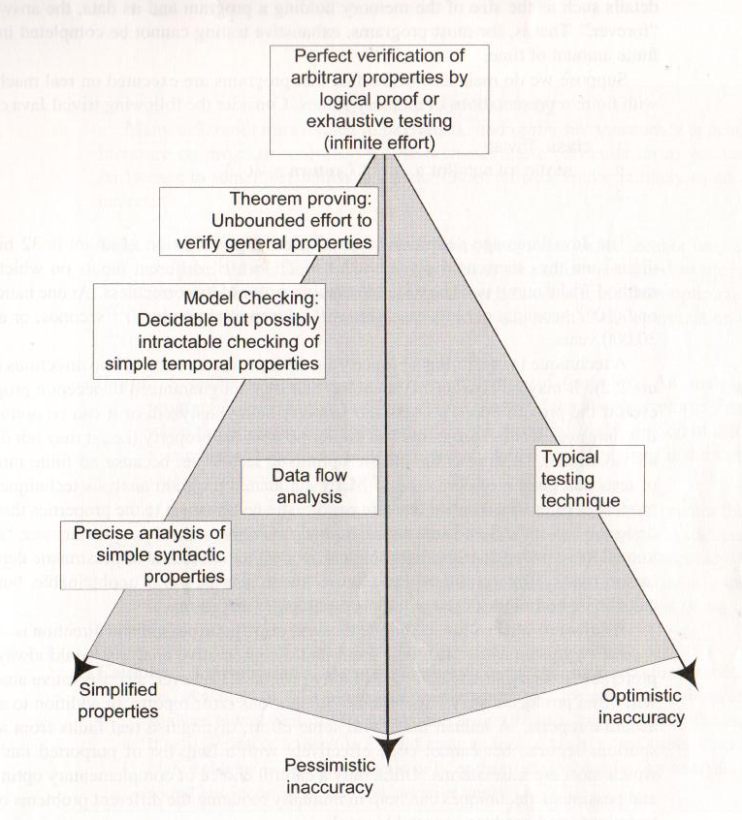
Verification Trade-Offs
We are interested in proving that a program demonstrates property X
Pessimistic Inaccuracy - not guaranteed to program even if the it possesses X.
Optimistic Inaccuracy - may accept program that does not possess X.
Property Complexity - if X is too difficult to check, substitute simpler property Y.
Notes:
So, the question of which verification technique applies involves making trade-offs across three dimensions of inaccuracy -pessimistic inaccuracy, optimistic inaccuracy, and simplicity of the property (1)
(read 2 - 3)
Testing is the classic optimistic technique, because no finite number of tests can guarantee correctness. Instead, we aim to provide evidence that we did “good enough”.
Now, there is a third dimension to consider, which is the complexity of the property that you wish to verify. (read)that is easier to check or constrain the types of programs checked
If we aren’t willing to accept the optimistic inaccuracy of testing and the only other technique is too pessimistic, well.. maybe we know of a similar property that is correlated with the one of interest. If that property is simpler, and if it is a necessary condition for your property, then analyze that property instead. We may then be able to find precise violations rather than potentially missing violations or being flooded with false rejections.
(go over examples)

Slide 57
How Can We Assess Readiness?
Finding all faults is nearly impossible.
Instead, decide when to stop V&V.
Need to establish criteria for acceptance.
How good is “good enough”?
Measure dependability and other quality attributes and set threshold to meet.
Notes:
Most of the things we cover in this class are done with the goal of identifying, locating, or removing faults, and that’s obviously something useful. But, finding all faults is a pipe dream. It’s nearly impossible, and definitely not cost effective. Verification can’t go on forever. So, at some point, we need to make a judgement call - is this ready to go. You need to be able to make that call, and to do so, you need a plan in place.
(read 3 -4)
Now, one option is to measure the level of dependability - there are metrics that can be used such as the availability - the uptime over the execution time - or the mean time between failues - the average amount of time that passes before something goes wrong. We will cover these more later. But, you can track these dependability metrics throughout development, simulate the use of the system, take down updated figures, and declare the system ready once that threshold is met.

Slide 58
Product Readiness
Put it in the hands of human users.
Alpha/Beta Testing
Small group of users using the product, reporting feedback and failures.
Use this to judge product readiness.
Make use of dependability metrics for quantitative judgement (metric > threshold).
Make use of surveys as a qualitative judgement.
Notes:
Another option is to (1). This is almost always a good idea at some point - people will find ways to break your software that you never imagined. So, at some point, you want to start brining in those users. First, with alpha testing, where a tiny group of select people are given access to the software in a controlled environment, observed by the developers. Then in beta testing, an even larger crowd gets their hands on the product in their own operating environment, without interference or close monitoring from the developers. At both stages, you can perform quantitative studies of the software dependability, measuring those reliability metrics. You can also perform qualitative analysis by surveying the users and their opinions - asking them if they actualyl like the software.(are the users happy with the current product?)

Slide 59
Ensuring Quality of Successive Releases
V&V do not end with the release of the software.
Software evolves - new features, environmental adaptations, bug fixes.
Need to test code, retest old code, track changes.
When code changes, rerun tests to ensure tested elements still works.
Retain tests that exposed faults to ensure they do not return.
Notes:
(read)

Slide 60
Improving the Development Process
Try to learn from your mistakes in the next project.
Collect data during development.
Fault information, bug reports, project metrics (complexity, # classes, # lines of code, test coverage, etc.).
Classify faults into categories.
Look for common mistakes.
Learn how to avoid such mistakes.
Share information within your organization.
Notes:
Finally, that last question to keep in mind is how the development process can be improved as a result of verification and validation -aka: learn from your history and don’t make the same mistakes over again.
(read)

Slide 61
We Have Learned
Quality attributes describe desired properties of the system under development.
Dependability, scalability, performance, availability, security, maintainability, testability, ...
Developers must prioritize quality attributes and design a system that meets chosen thresholds.
Quality is often subjective. Choose a definition, and offer objective thresholds.

Slide 62
We Have Learned
Software should be dependable and useful before it is released into the world.
Verification is the process of demonstrating that an implementation meets its specification.
This is the primary means of making software dependable (and demonstrating dependability).
Testing is most common form of verification.
Notes:
the third feature we would like is completeness.
(read) - that is, for all programs that do satisfy the property, you get a true back. This is like soundness. In soundness, if you get a true, that means it is true - you can’t get a true when it is actually false. Here, you can’t get a false if the property is true.if you get a false, it must be false.
(read) You can get incorrect true verdicts, but not incorrect false verdicts.
(read)

Slide 63
Next Time
Measuring and assessing quality.
Pezze & Young - Chapter 4
Other reading on Canvas
Plan your team selection.
The earlier, the better! Due January 26, 11:59 PM.
Three people, e-mail names to ggay@chalmers.se
Let me know if you want assigned to a team.

